Slide 1


Reverse-Forward Software Engineering 逆正向软件工程
Haikuan Li, Visiting Professor
CLEBA Group, Delfgauw
The Netherlands
Haikuan Li “Software Development of Datafication Intelligence Architecturalization and Intensification (Lecture Notes)” Seminar on Intelligent Software Development at Northwestern Polytechnical University(NPU), Xi’an, China, 2020
Notes:
The title of the course is “Software Development Paradigm in the Era of Big Data”.

Slide 2
Reverse-Forward Engineering 逆正向软件工程
In the era of big data, large-scale or very-large-scale software reuse has changed the process of software development. Software data mining and reverse engineering are gradually becoming the primary task of software development, and then general (forward) software engineering begins. This kind of software development process of doing reverse engineering first and then forward engineering is the so-called reverse engineering.
在大数据时代，大规模或超大规模软件复用改变了软件开发的流程，软件数据挖掘与逆向工程正逐渐成为软件开发的首要任务，然后才开始一般的（正向）软件工程。这种先做逆向工程，再做正向工程的软件开发过程，即所谓的逆正向工程。

Slide 3
Software development with reuse
It is known, Google’s machine translation is highly based on reusing what has been translated, and the progress of the translation has been made significantly.
In the last decades, software development from scratch is getting less and less, while, with reusing existing resources, is getting more and more.
According to Stojanovic (2005), “Software development projects nowadays rarely start from scratch. It is often necessary to take into account
Existing legacy assets,
Third-party software packaged,
COTS components (The Commercial-Off-The-Shelf components) or even
Web services”.
And also during the last decades, a large amount of software resources has been produced; Software reuse is proved significant to improve the quality and productivity of software development; to support software reuse, reverse engineering, one of the traditional technologies for software maintenance is now playing an important role for software development, resulting reverse-forward engineering.

Slide 4
Reverse-Forward Engineering
The “Reverse-Forward Engineering” as addressed in this lecture looks radicular. Generally speaking, without forward engineering, we have nothing to reverse. While the situation has been changed in the era of big data.
Forward Engineering is the traditional process of moving from high-level abstractions and logical designs to the physical implementation of a system {Chikofsky-90}
Reverse Engineering is the process of analyzing a subject system to identify the system's components and their interrelationships and create representations of the system in another form or at a higher level of abstraction” {Chikofsky-90}.
Reverse-Forward Engineering simply means doing reverse engineering the first, then start forward engineering next. How is that?

Slide 5
Reverse Engineering vs Forward Engineering
Software Engineering:
Reverse Engineering:
Forward Engineering:
System = Architecture + {Component}
System → Architecture + {Component}
System ← Architecture + {Component}

Slide 6
Office System：
Micro/Google/Kingsoft
Reverse-Forward Engineering
Reverse-forward engineering is a process to develop a target software system with reusing existing systems. To make an existing system reusable, reverse engineering is applied, resulting reusable artifacts to support software development. The process is called reverse-forward engineering because reverse engineering have to be done before forward engineering.
Legacy System
New System
Reverse Engineering
Forward Engineering
Reusable Artifacts

Slide 7
Software (Data) Mining VS Reverse Engineering
Software data mining: Analyzing static and active software resources of an application domain and recovering the knowledge and reusable artifacts from the resources, so that to support software development with large-scale reuse.
Reusable artifacts refers to any accessible parts of software resources that may be applicable in developing other systems.
Accordingly, software data mining covers more activities than reverse engineering, which is able to reuse the knowledge and artifacts of an existing software resources in a more broad way.
Software Resources
Software Data Mining
Reusable Artifacts
Forward Engineering
New System

Slide 8
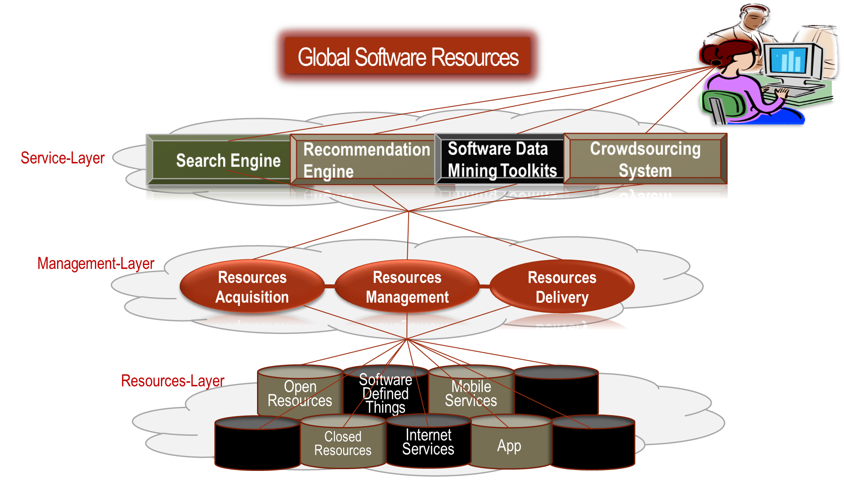
The Process of Software Development
in the era of Big Data
Global Software Resources
Software Products
Software Data Mining
Crowd Sourcing
Domain Resources
Management
Intensive Software Development
+Maintenance
Reusable
Artifacts
Reusable
Artifacts

Slide 9
Software Development Paradigm in the Era of Big Data
Software Products
Global Software Resources
Intensive Development
Domain Management
Reusable
Artifacts
服
务
层
搜索
引擎
推荐
引擎
数据挖掘
工具包
众包
平台
Software
Mining
Reusable
Artifacts
Domain Management
Software Products
Software Mining
Reusable
Artifacts
Reusable
Artifacts
Intensive Development
管
理
层
资源
获取
资源
管理
资源
提交
。。。。
Software Products
。。。。k
Reusable
Artifacts
Reusable
Artifacts
。。。。
资源层
开放资源
软件定义资源
移动
服务
物联
资源
非开放资源
互联网服务
App
Domain Management
Intensive Development
Software Products
Software Mining
Reusable
Artifacts
Reusable
Artifacts

Slide 10
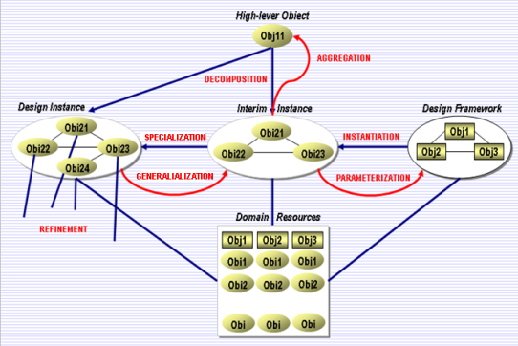
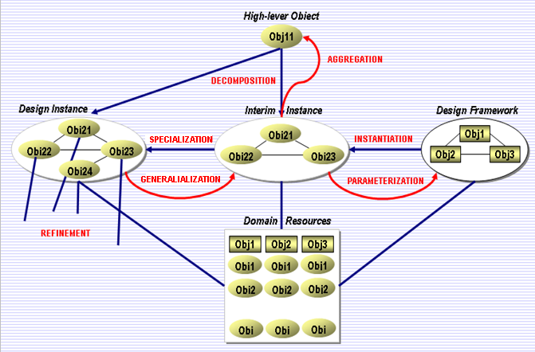

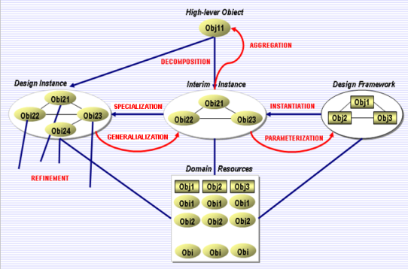
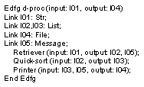
Domain-Based Intensive Software Development
New
Systems
Global Software Resources
Software Data Mining
Domain
Resources Management
Intensive
Software Development
Reusable
Artifacts
Reusable
Artifacts
Software Data Mining
Organization Model
Operational Model
Reusable Artifacts
Reusable Artifacts
Reusable Artifacts
Reusable Artifacts
User Interface
Software mining
Legacy Systems
Legacy Systems

Slide 11

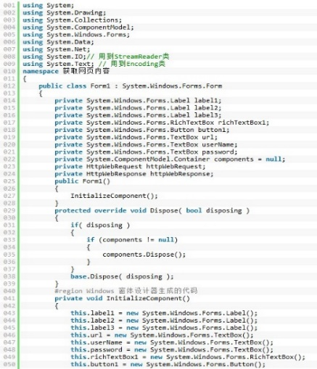
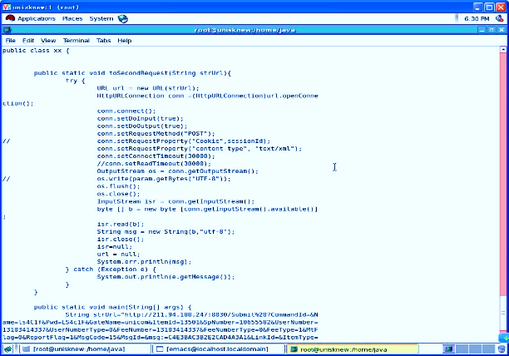
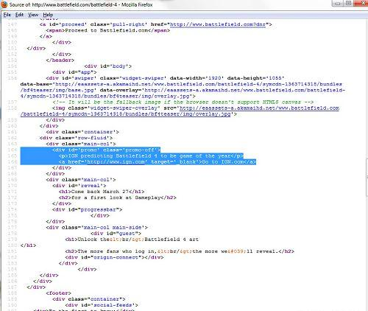
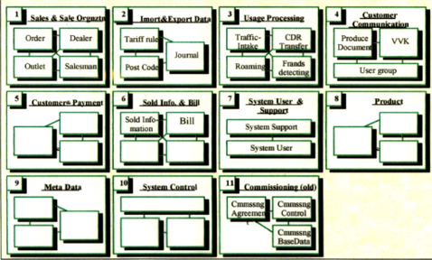
Software Data Mining / Reverse Engineering
Archit ecture
Transformation
Architecture
Recovery
Architecture
Implantation

Slide 12
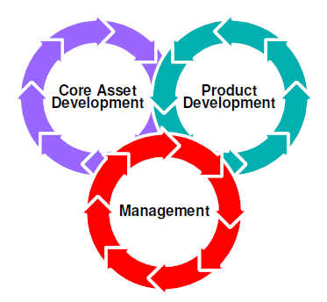
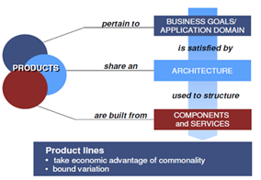
Product Line Organizational Model
About how software resources are organized for reused.
Software Product Line
Organizational Model
An Architecture-Based Model
for resources management
12

Slide 13
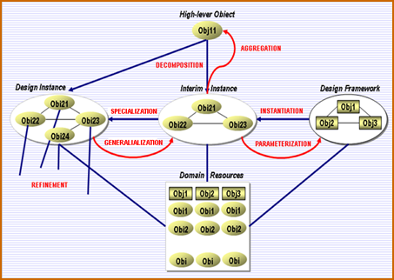
Product Line Operational Model
Operational Model: The activities of software development
with reuse and for reuse.
Software Product Line
Operational Model
13

Slide 14
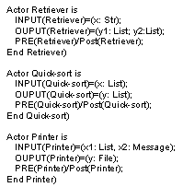
Product Line User Interface A prescribed way of software development.
Software Product Line
User Interface
14

Slide 15

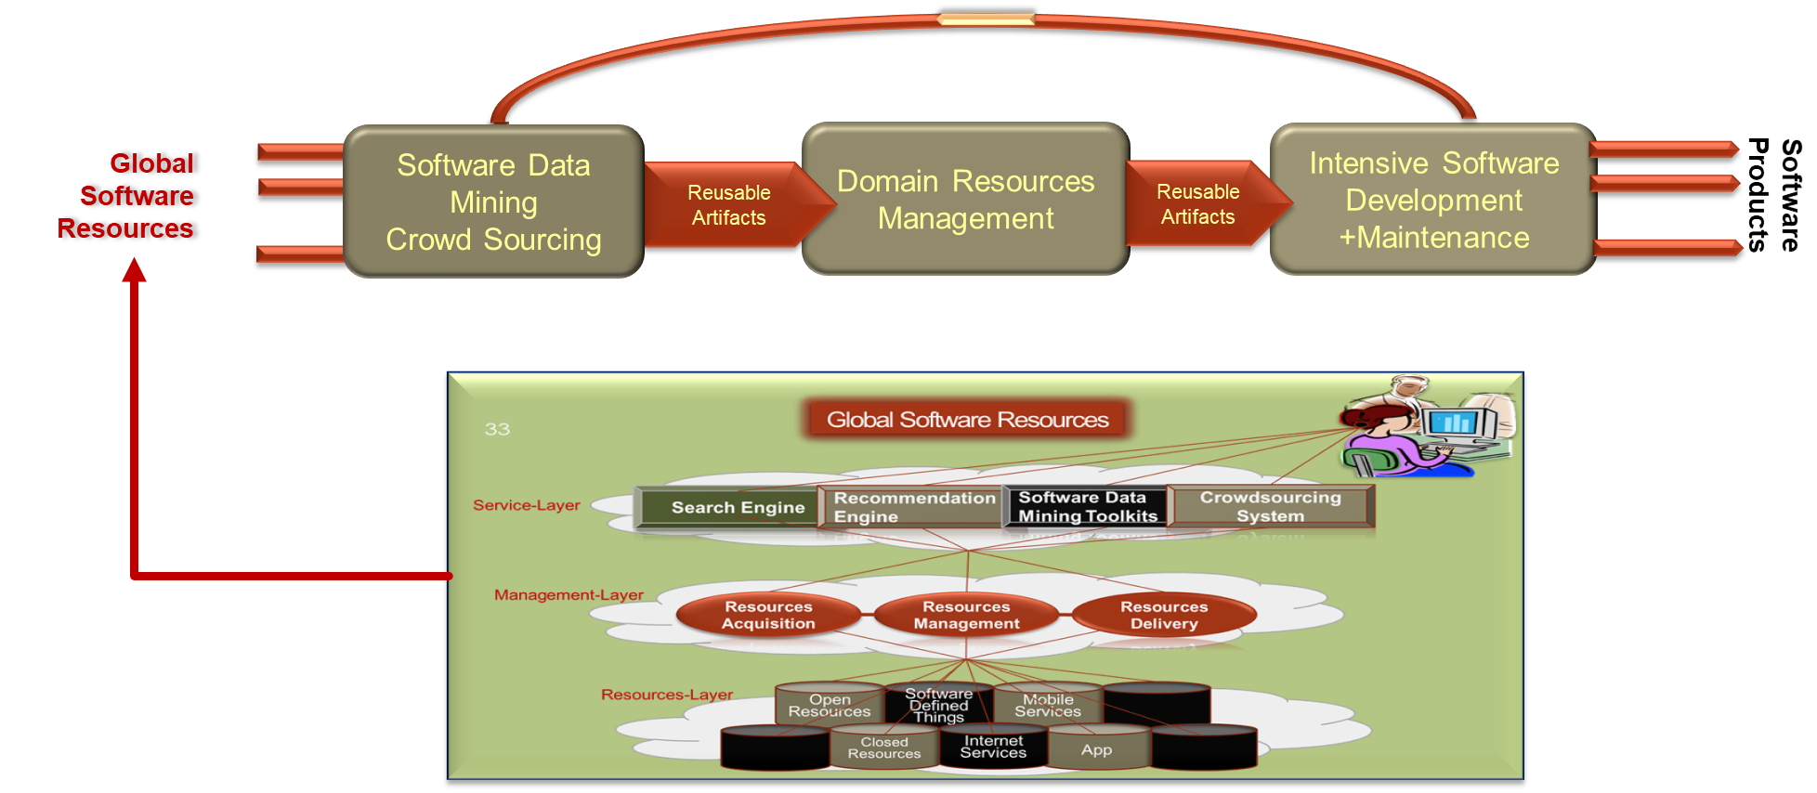
Q&A

Slide 16
Q&A：Reverse Forward Engineering
What is reverse engineering?
What is forward engineering？
What is reverse-forward engineering?
Why is there revers-forward engineering？
What is software data mining?
What is the difference between data mining and software data mining?
What is the process of software development in the era of big data?
What is intensive software development?
What is software product line?

